Slide 1

CLASH OF CODERS 3.0 HACKATHON 2026
Techfinity 1.0
Problem Statement Title - A school can support only 20% of students. Build a fair ranking system that identifies students most in need of support while ensuring equitable recall across student groups.
Theme - Responsible & Explainable AI (XAI) in Education
Team Name – Techfinity 1.0

Slide 2
AURA — FROM STUDENT DATA TO FAIR SUPPORT
HARD LIMIT
20% OF STUDENTS
One transparent pipeline: predict need → use the limited support budget → audit whether the ranking is fair.
01
STUDENT DATA
02
RISK SCORE
03
PRIORITY RANK
04
FAIRNESS AUDIT
Input snapshot for each student.
Convert the student profile into a support-needed probability.
Sort students by predicted need and select exactly the top 20%.
Check whether support-needed recall is balanced across eligible groups.
USES
USES
USES
USES
G1 + G2 grades • absences • failures
School + sex for cohort checks
Model outputs p(support needed)
Calibration tracked with Brier score
1 → N ranking by probability
Top ⌈0.20 × N⌉ become the support cohort
Rₘᵢₙ = worst-group recall
Fairness gap = largest recall difference
Utility + calibration reported
WHY HERE
WHY HERE
WHY HERE
WHY HERE
These are the permitted signals used to estimate support need; G3 is the target, not an input.
A probability is more informative than a yes/no label: it lets us rank students under a fixed budget.
The school has limited capacity, so the model must turn probabilities into a concrete, auditable allocation.
This is the safety check after ranking: a strong overall score is not enough if one eligible group is consistently missed.
HOW THE PROTOTYPE MAKES THE DECISION EXPLAINABLE
These three views are not separate models — they explain, stress-test and inspect the same ranked list.
A
3D COHORT EXPLORER
B
PARITY ARENA
C
WHAT-IF + BOUNDARY TEST
Plots G1 vs G2 with support probability as the 3rd dimension; filters distress, passing students and cohorts.
Shows recall for eligible cohorts and compares the proposed prioritizer against greedy and random baselines.
Simulates support changes and inspects students near the cut-off (e.g., rank #78 vs #80).
WHY
Lets a teacher inspect *why* a student appears high-risk and see the academic trajectory behind the score.
WHY
Makes fairness measurable instead of claiming it; the same ranking can be compared on recall and gap.
WHY
Tests sensitivity: would a small intervention change risk, and is the 20% boundary defensible?
CORE PRINCIPLE • Predict transparently. Allocate exactly 20%. Audit group-level recall. Then inspect the borderline cases before acting.
Notes:
Source basis: ED-01 problem statement requires a binary support-needed probability model, ranked support list, exact top-20% selection, group-wise utility/fairness metrics, and responsible-use analysis. G3 is used to define support_needed but must not be an input. The prototype implements G1/G2, absences, failures, school and sex; it exposes a 3D cohort explorer, parity/fairness arena, counterfactual what-if controls, and rank-boundary inspection.

Slide 3
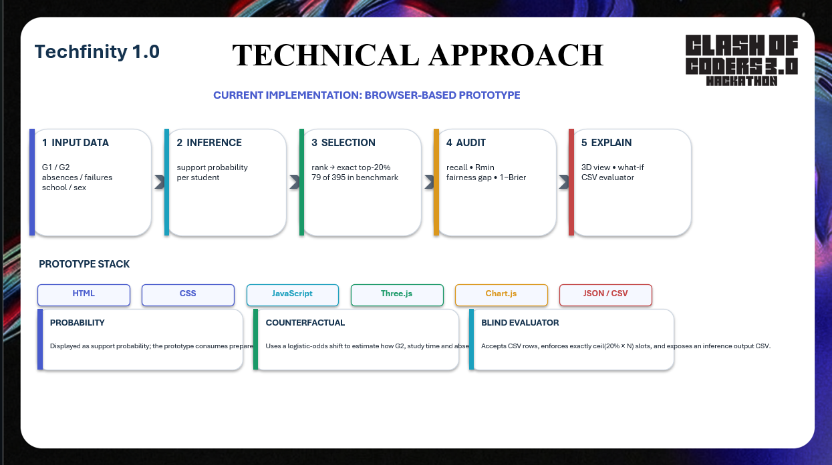
Techfinity 1.0
TECHNICAL APPROACH
HACK OF
HACKERS 3.0
CURRENT IMPLEMENTATION: BROWSER-BASED PROTOTYPE
1 INPUT DATA
2 INFERENCE
3 SELECTION
4 AUDIT
5 EXPLAIN
G1 + G2
absences + failures
school + sex
support-needed
probability per student
sort by probability
→ exact ⌈0.20 × N⌉
79 of 395 in benchmark
recall • Rₘᵢₙ
fairness gap • 1−Brier
3D cohort view
what-if + boundary test
CSV evaluator
WHY HERE
WHY HERE
WHY HERE
WHY HERE
WHY HERE
These are the permitted signals used for support-risk scoring and group fairness checks.
A continuous probability lets the system rank students instead of forcing an early yes/no decision.
The 20% capacity is fixed, so the ranked scores must become an exact, auditable support cohort.
A strong ranking is not enough; this step checks worst-group recall, parity and calibration.
These tools let a reviewer inspect the score, test sensitivity and verify the same ranking independently.
PROTOTYPE STACK
HTML
CSS
JavaScript
Three.js
Chart.js
JSON / CSV
PROBABILITY
COUNTERFACTUAL
BLIND EVALUATOR
Displayed as the support-needed probability and used directly for ranking. Calibration is checked with Brier score.
Applies a logistic-odds shift when G2, study time or absences are hypothetically changed.
Accepts CSV rows with G3 removed, computes exactly ⌈0.20 × N⌉ slots, and exposes the inference output CSV.
WHY
Continuous risk makes the top-20% selection reproducible and lets reviewers see model confidence.
WHY
Shows how an intervention could change projected risk without changing the stored student record.
WHY
Tests the deployed inference path on unseen rows without allowing the target to leak into the decision.
END-TO-END: INPUT → SUPPORT PROBABILITY → EXACT 20% SELECTION → FAIRNESS / CALIBRATION AUDIT → HUMAN EXPLANATION
ED-01 • Responsible & Explainable AI in EdTech | Prototype view for judges
AURA • Fair Student-Support Prioritization
Notes:
Source-grounded technical approach based on the submitted browser prototype and ED-01 brief. Prototype UI is implemented with HTML/CSS/JavaScript, Three.js and Chart.js, with JSON/CSV data/evaluator flows. The ranking uses support-needed probability, selects exactly ceil(0.20*N), and audits recall, worst-group recall, fairness gap and calibration. G3 is target-only for the benchmark; the blind evaluator accepts rows with G3 removed. The counterfactual lab uses a logistic-odds shift for hypothetical G2, study-time and absence changes.

Slide 4
FEASIBILITY AND VIABILITY
Techfinity 1.0
WORKING PROTOTYPE
SOFTWARE-ONLY
EVALUATION READY
Four judge-facing views are already wired: overview, 3D constellation, parity arena and what-if/evaluation lab.
Runs in a browser; no special hardware or deployment infrastructure is required for the demo.
The UI exposes benchmark metrics and a CSV upload path for blind evaluation.
RISKS & MITIGATIONS
Data quality / missing values
Keep student IDs opaque; evaluate on structured CSV input and inspect boundary cases.
Fairness metric trade-offs
Report group recall + Rmin + fairness gap together instead of optimizing one number only.
Threshold sensitivity
Keep the allocation rule explicit: exactly ceil(0.20 × N) support slots.
Privacy / misuse risk
Use support as affirmative, non-punitive intervention; the prototype notes that support is excluded from public records.
Feasibility claim: the prototype demonstrates the full decision → audit → explanation loop without requiring a new hardware stack.

Slide 5
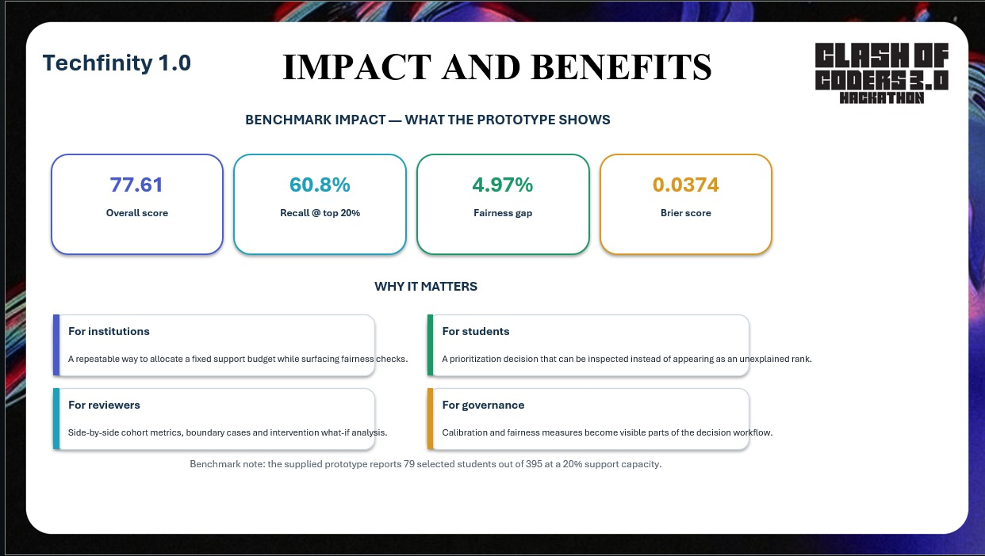

Techfinity 1.0
IMPACT AND BENEFITS
BENCHMARK IMPACT — HOW THE DATA DRIVES AURA
G1 + G2 | ACADEMIC
FAILURES + ABSENCES + STUDY
SCHOOL + SEX + AGE
G3 | TARGET / EVALUATION
Recent exam scores → used as the strongest direct view of current performance and the change from Period 1 to Period 2.
Persistence & context → used to explain support need and tailor intervention scenarios, not simply rank students.
Cohort & audit context → used for group views and parity checks so model quality is visible across groups.
Future outcome → used to measure recall/calibration after selection; stripped from blind test inputs to avoid leakage.
77.61
60.77%
4.97%
0.0374
AURA score
Top-20% recall
Fairness gap
Brier score
overall utility
need captured in fixed budget
group recall difference
probability calibration error
WHY IT MATTERS
FOR INSTITUTIONS
FOR STUDENTS
20% support capacity is enforced deterministically: 79 of 395 students are selected for support.
G1→G2 trajectory + support probability makes the decision inspectable; support stays affirmative and non-punitive.
FOR REVIEWERS
FOR GOVERNANCE
Recall, worst-group recall, fairness gap and calibration can be inspected together against model baselines.
School/sex groups are audited separately, while blind CSV testing removes G3 so evaluation reflects real prediction.
DATA FLOW: G1/G2 + context → support probability → rank top 20% → fairness audit → targeted support → evaluate with G3.
TECHFINITY 1.0 • AURA / FAIR STUDENT-SUPPORT PRIORITIZATION
ED-01 • 01

Slide 6
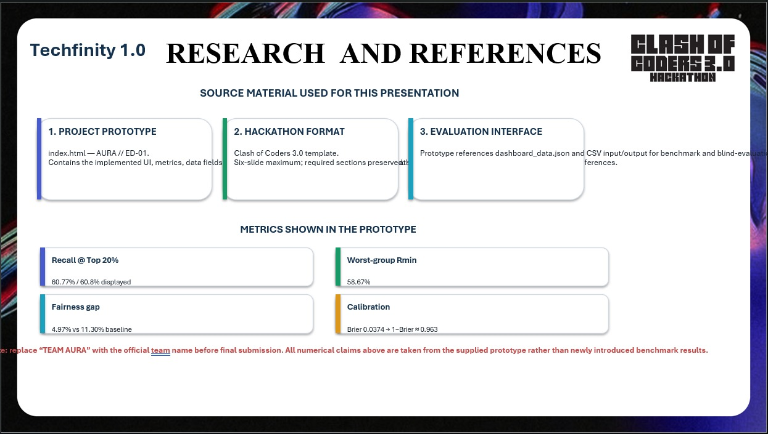
Techfinity 1.0
RESEARCH AND REFERENCES
SOURCE MATERIAL USED TO BUILD AND VALIDATE AURA
1. AURA PROTOTYPE — index.html
2. UCI STUDENT PERFORMANCE — DATASET
3. COC SELF PDF — HACKATHON CONTEXT
UCI SOURCE
Used for the implemented workflow, UI terminology and benchmark numbers. It exposes Overview, 3D Constellation, Parity Arena and What‑If/Lab views — so each reference here maps to a real product screen.
Primary research/data reference. UCI documents 649 students and 30 features from two Portuguese schools. AURA uses the student/academic fields needed for support prioritization; G3 is treated as the outcome, not a live input.
Used to align the slide with the competition framing and submission expectations. It is the project brief/reference layer; the prototype and UCI dataset supply the actual technical evidence shown here.
archive.ics.uci.edu/dataset/320/student+performance
Cortez, P. (2008) • DOI 10.24432/C5TG7T
DATA FIELDS USED IN AURA • WHAT THEY ARE FOR
ACADEMIC SIGNALS → PRIORITIZATION
CONTEXT SIGNALS → FAIRNESS & INTERPRETATION
G1 + G2 track current performance and trajectory; failures add prior academic-risk context. Used to estimate support need and rank students.
School, sex and age identify cohorts for fairness audits and make a decision explainable without changing the allocation rule.
BEHAVIOUR / ACCESS → SUPPORT PLANNING
G3 → OUTCOME / EVALUATION ONLY
Absences, study time and travel time describe practical barriers. Used to tailor the type of affirmative intervention, not to label students publicly.
Final grade (G3) is the prediction/evaluation target. It is withheld from blind evaluation inputs so the model is judged without target leakage.
REFERENCE NOTE
UCI describes G1 and G2 as 1st/2nd-period grades and G3 as the final grade; its feature list also includes school, sex, age, studytime, failures and absences. AURA’s prototype turns these fields into a transparent support-prioritization workflow, while its blind evaluator strips G3 before scoring.
TECHFINITY 1.0 • AURA / RESEARCH & REFERENCES
UCI DATASET 320 • 01

